Slide 1

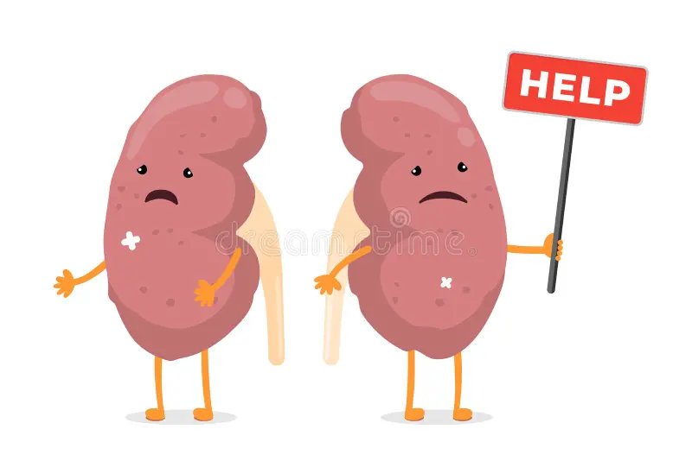
Acute Kidney Injury and Liver Transplantation
9/26/2024
Mohammad Almeqdadi, MD

Slide 2
Questions
Why does AKI happen in cirrhosis?
Why does AKI happen post liver transplant?
What are the pre-operative risk factors for AKI?
How to mitigate risk of post-liver transplant AKI?
How about SLK?

Slide 3
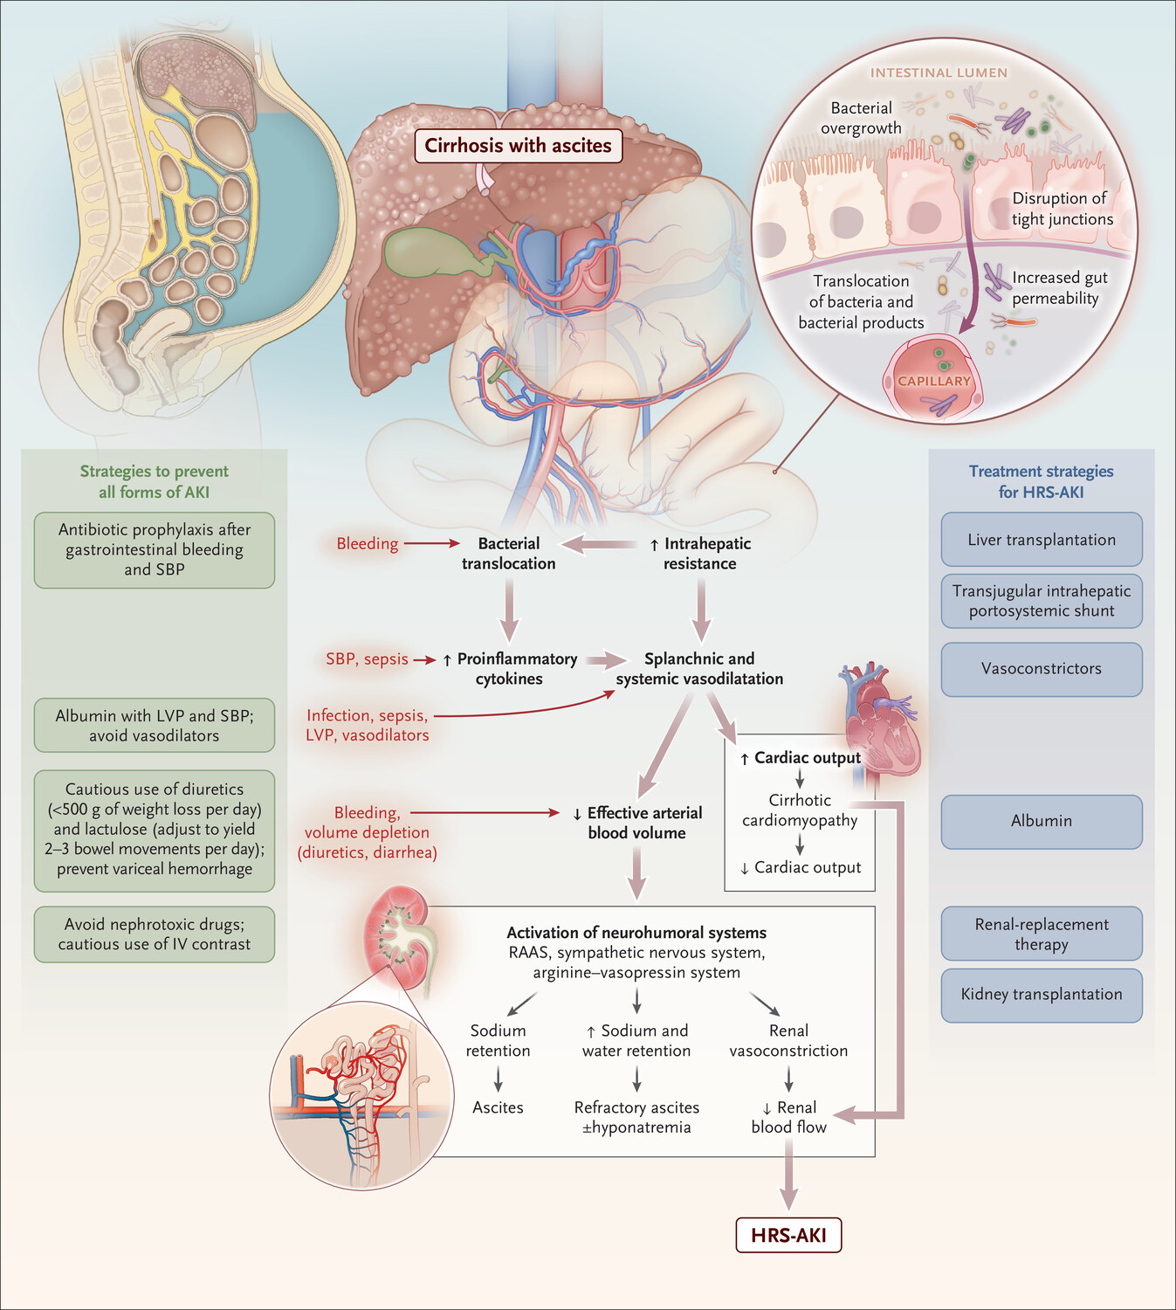
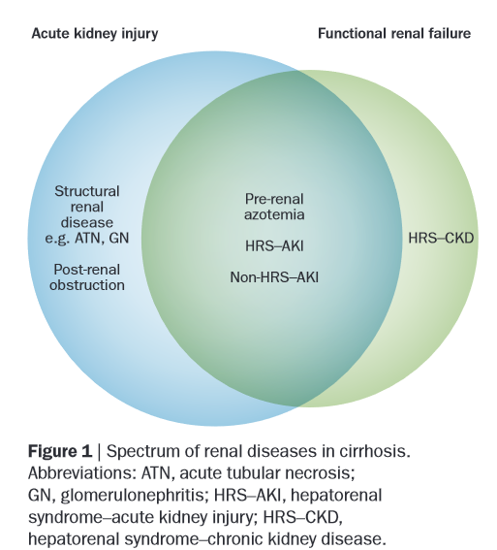
AKI in Cirrhosis
Nat Rev Gastroenterol Hepatol. 2015 Dec;12(12):711-9
N Engl J Med. 2023 Feb 23;388(8):733-745

Slide 4
Important points for AKI in liver transplant
Renal dysfunction after LT has been shown to be associated with higher post-LT mortality.
  28-day and 1-year mortality rates were 15.5% and 25.9%, respectively, in transplant recipients who developed AKI after LT compared with 0% and 3.9%, respectively, in those who did not develop AKI - Transplant Proc 2010;42:3634- 3638
Creatinine > 1.9 pre transplant shown to have OR of 3.6 for need of RRT post LTxp - Transplantation 2004;78:1048- 1054
While studies show poor short- and long-term survival (>1 year) for ESLD patients requiring RRT, it remains essential for potential liver transplant candidates to provide critical life-sustaining support.
  The duration of RRT in AKI is a key eligibility criterion for simultaneous liver-kidney transplantation (SLKT) candidacy. - Clin J Am Soc Nephrol. 2018;13:16–25, Medicine (Baltim). 2016;95:e3057

Slide 5
Risk factors for AKI post liver transplant

Slide 6
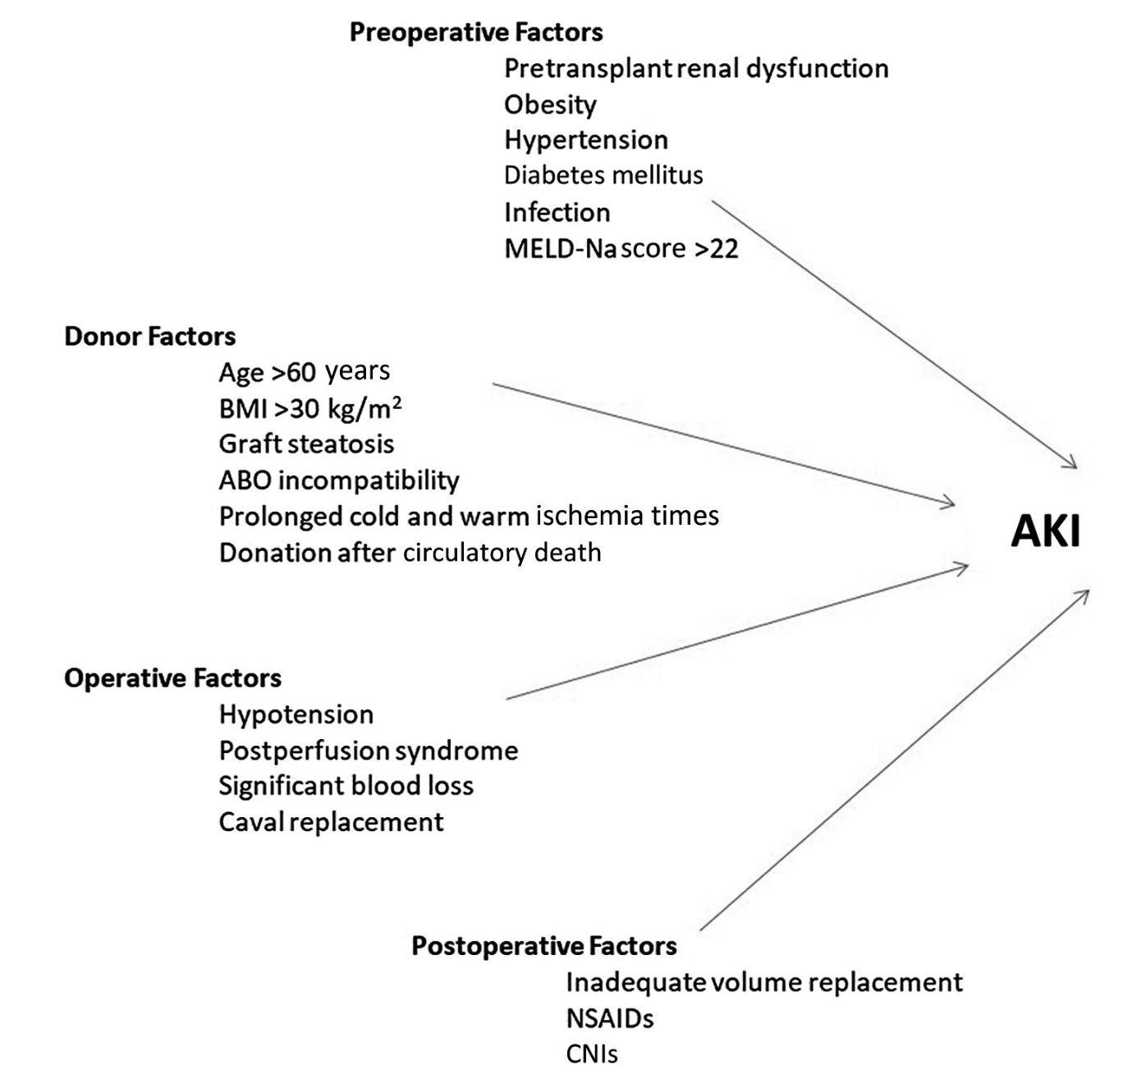
Liver Transpl. 2021 Nov;27(11):1653-1664

Slide 7

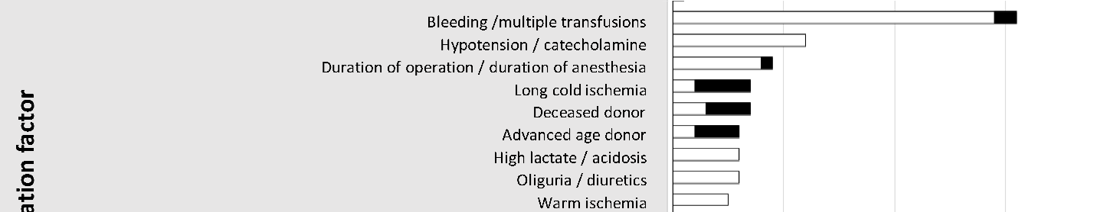

Pre Txp Factors
Intra Txp Factors
Post Txp Factors
Nephrol Ther. 2022 Apr;18(2):89-103

Slide 8
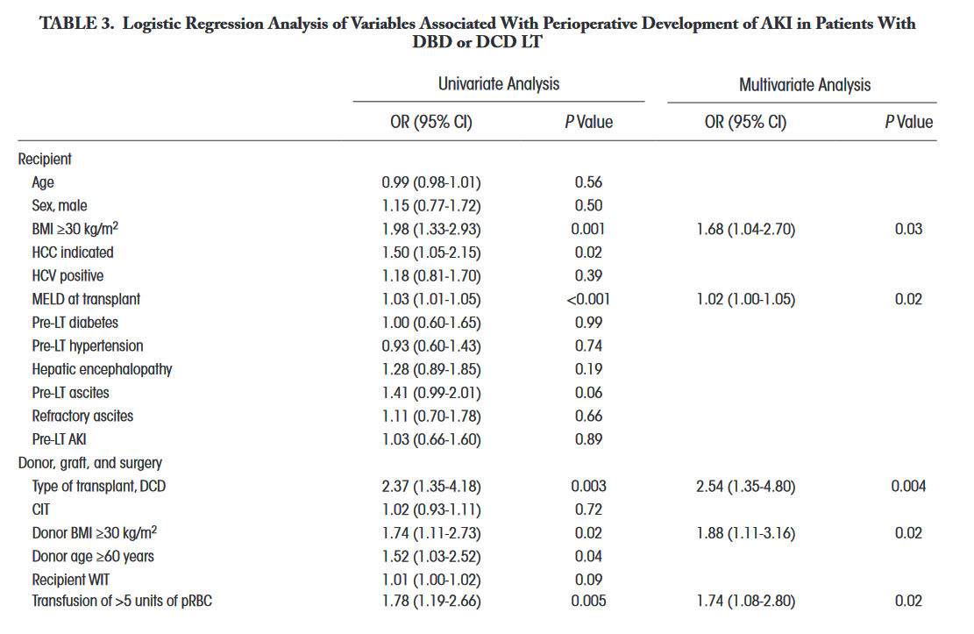
Liver Transpl. 2020 Jun;26(6):799-810

Slide 9
Liver Transpl. 2020 Jun;26(6):799-810

Slide 10
Does type of donor matter?
DCD vs DBD vs LDLT

Slide 11
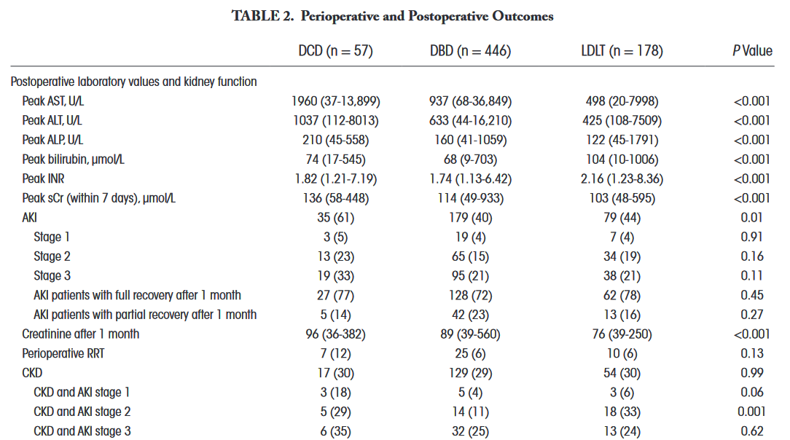
Liver Transpl. 2020 Jun;26(6):799-810

Slide 12
Liver Transpl. 2020 Jun;26(6):799-810

Slide 13
How can we mitigate the risk of AKI post liver transplant?

Slide 14
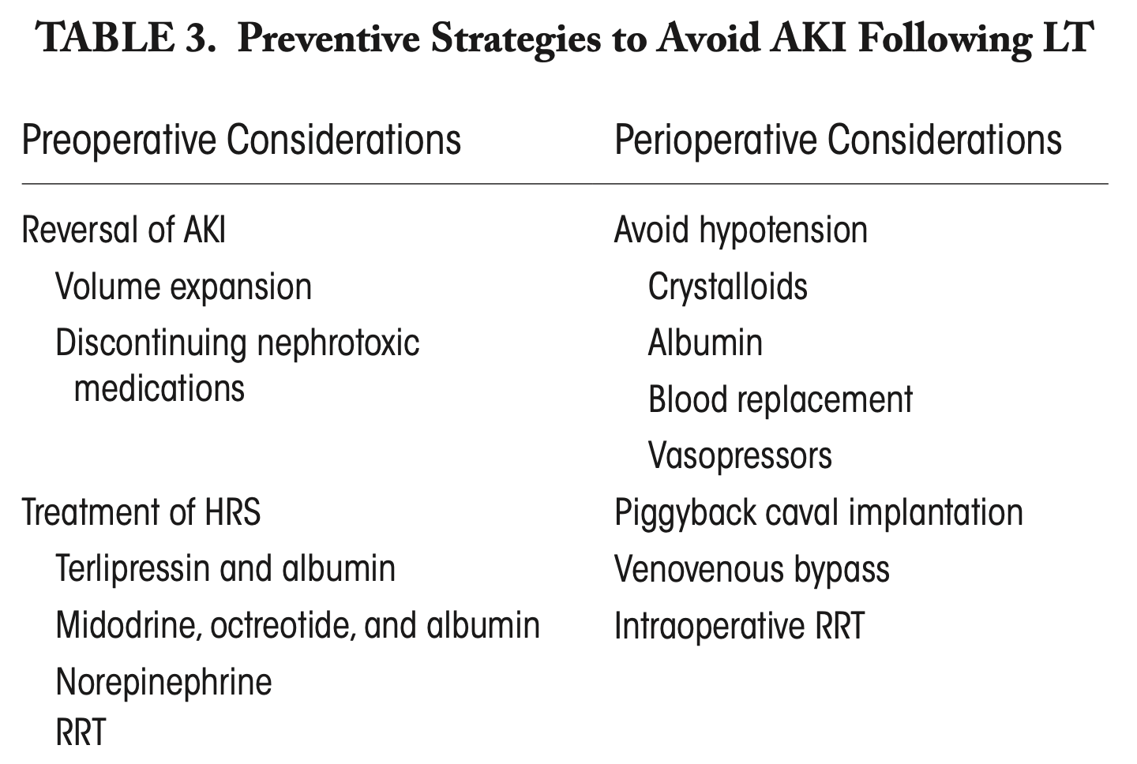
Liver Transpl. 2021 Nov;27(11):1653-1664

Slide 15
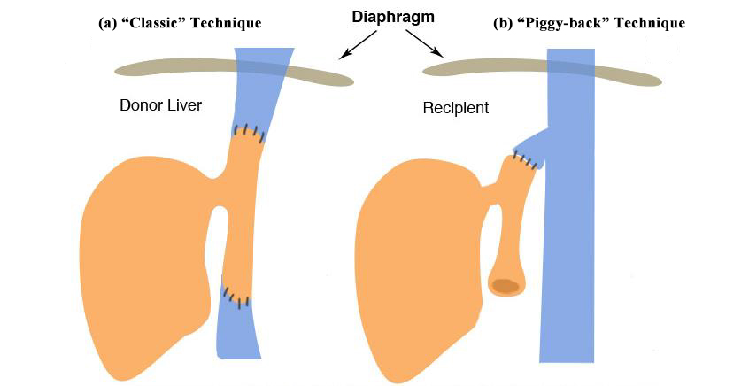
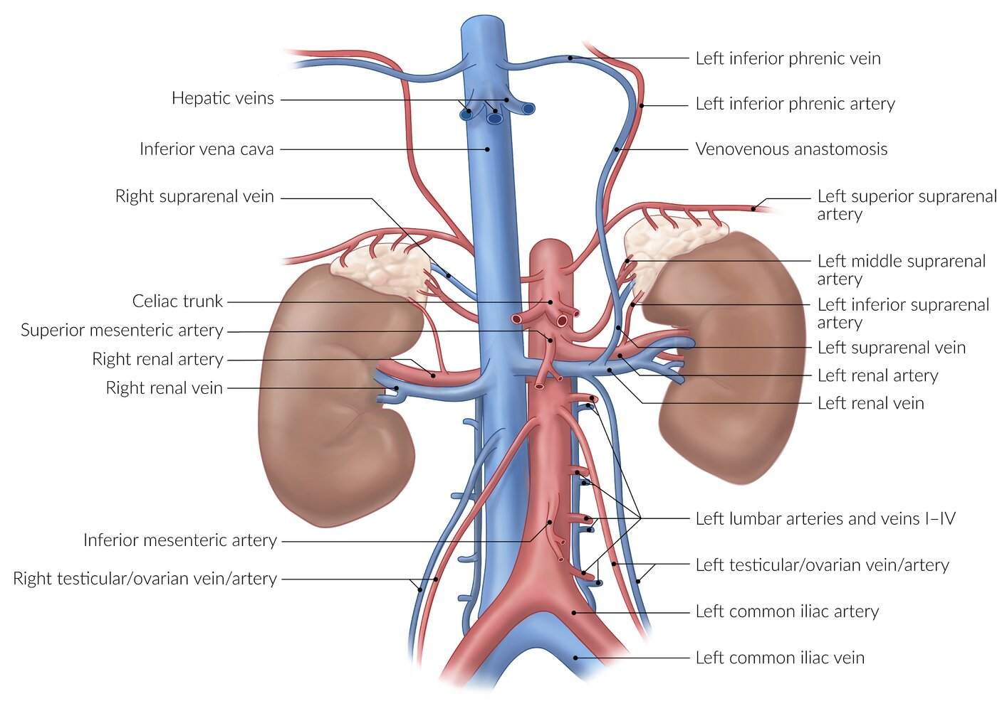
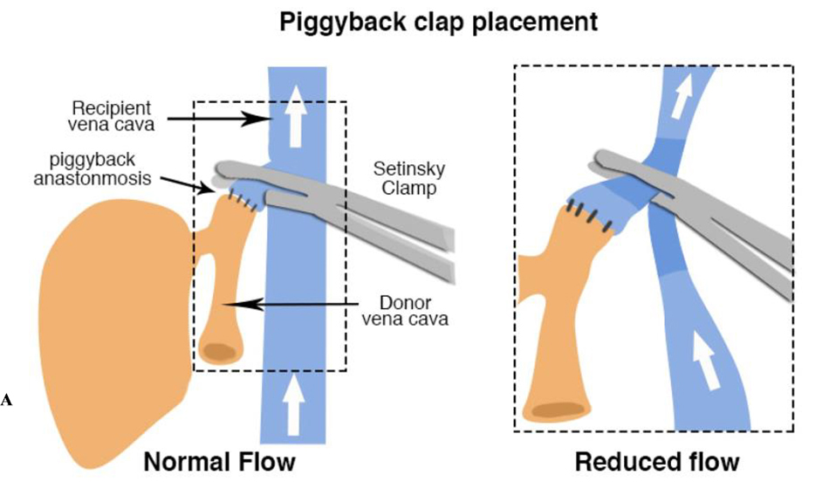
AMBOSS GmbH
https://resources.wfsahq.org/atotw/anaesthesia-for-orthotopic-liver-transplantation/

Slide 16
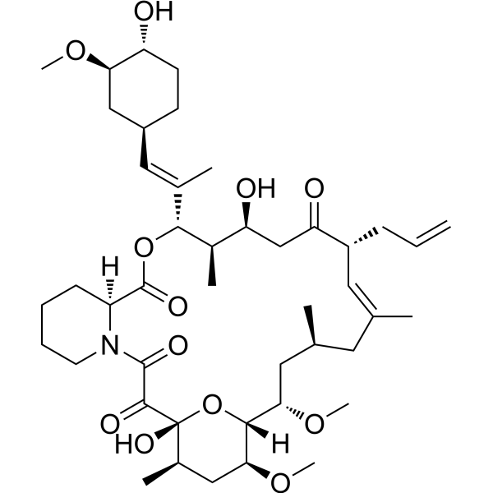

Slide 17
Tacrolimus

Slide 18
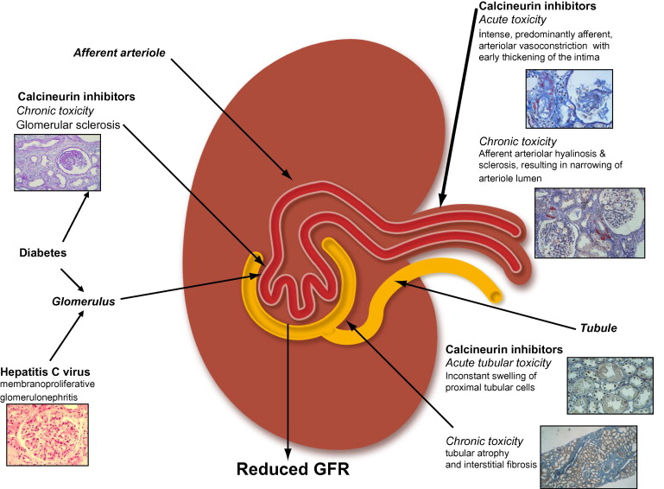
J Hepatol. 2011 May;54(5):1041-54

Slide 19
How can we prevent CNI nephrotoxicity?

Slide 20
How can we prevent CNI nephrotoxicity?
Simple… DO NOT USE CNI?!!!

Slide 21
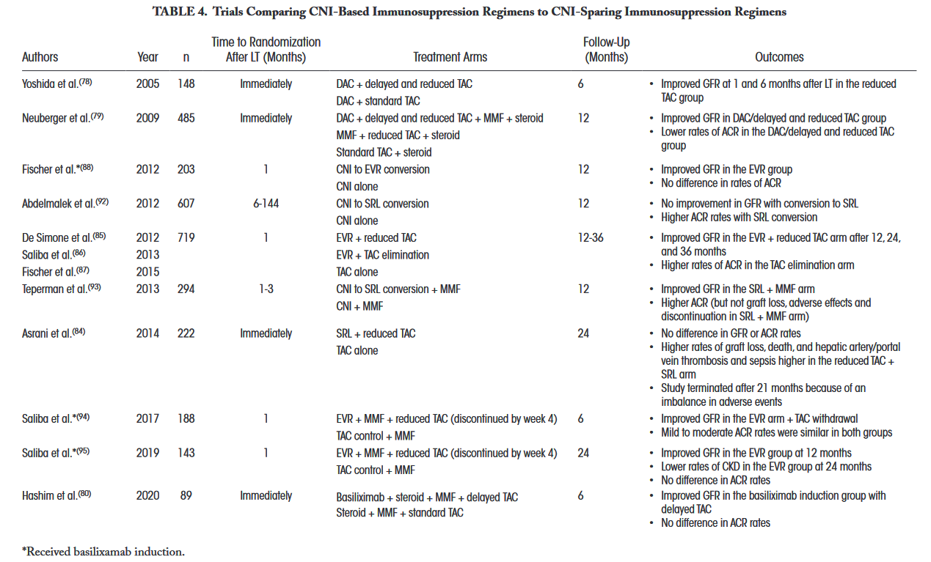
Liver Transpl. 2021 Nov;27(11):1653-1664

Slide 22
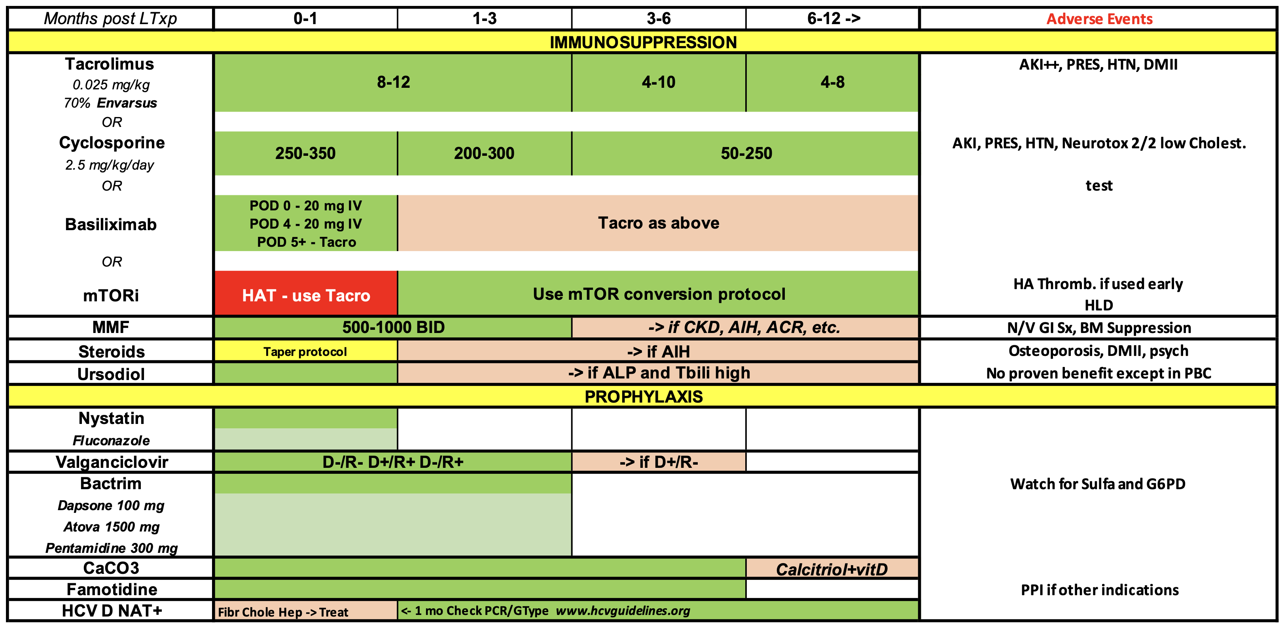

Slide 23
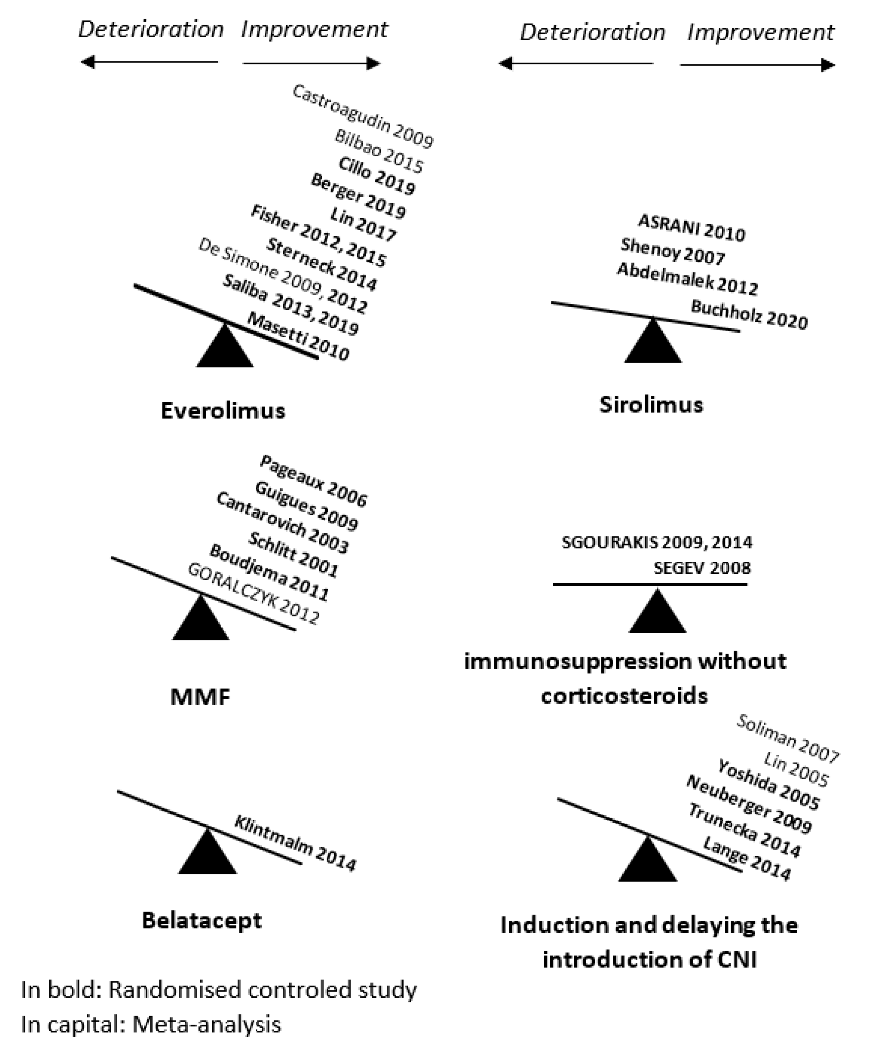
Nephrol Ther. 2022 Apr;18(2):89-103

Slide 24
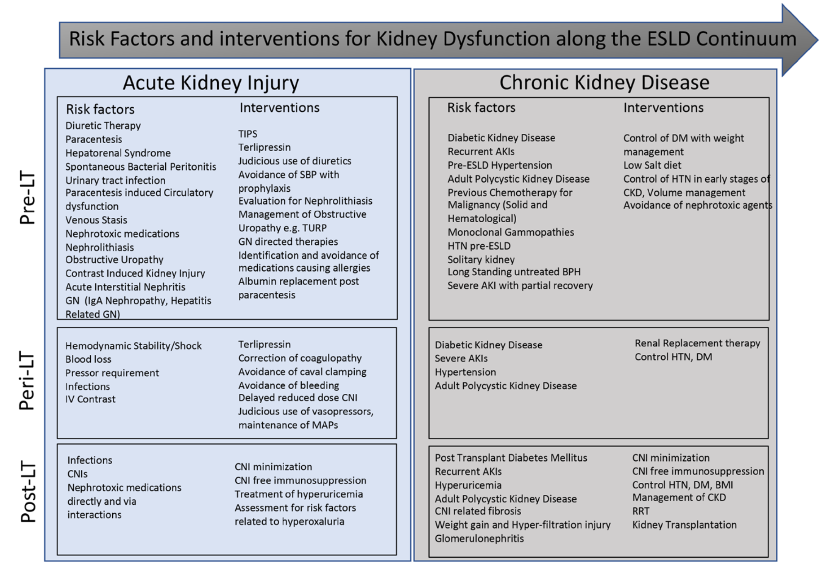
Transplantation. 2024 Jul 1;108(7):1542-1550

Slide 25
How about pathway to SLK?

Slide 26
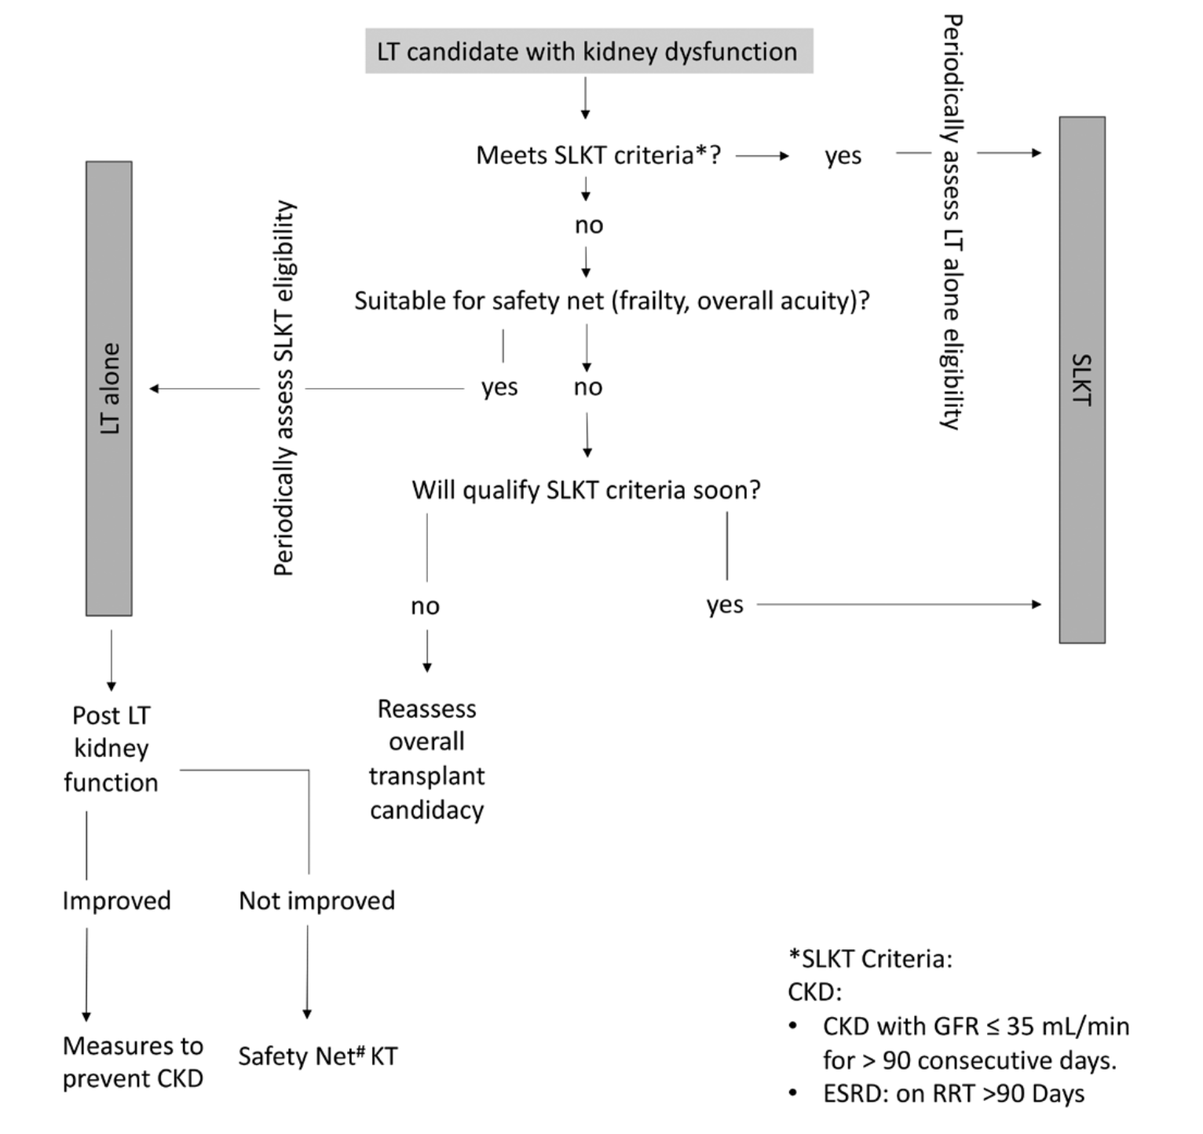
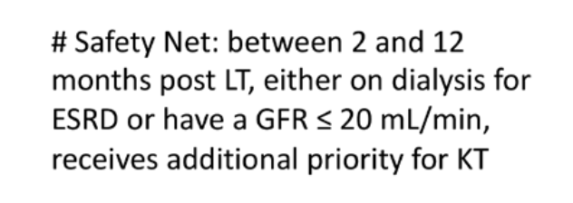
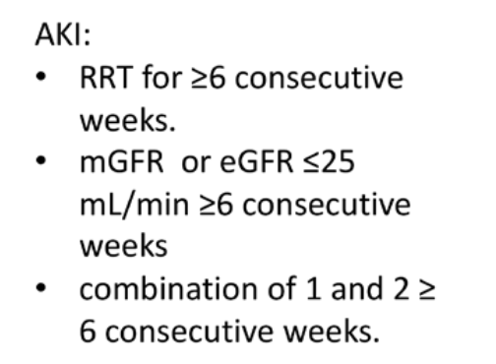
Transplantation. 2024 Jul 1;108(7):1542-1550

Slide 27
Thank you
Questions?

